Slide 1
TI Optimal Toolbox
specification

Slide 2
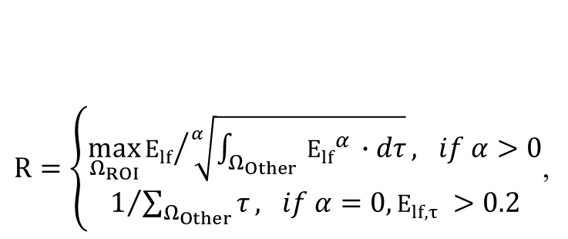
The optimal objective function
$R=\left\{\begin{aligned}{\max_{Ω_{ROI}}{E_{lf}}}/{\sqrt[α]{\int_{{Ω_{Other}}_{ }}{{E_{lf}}^{α_{ }}∙dτ}}}, if α>0 \\ 1/{\sum_{Ω_{Other}}{τ}}, if α=0,E_{lf,τ} >0.2\end{aligned}\right.$,
alpha_Other
0, caluculate the sum of volume above thres (0.2V/m)
>1, weighted sum of Elf
Inf, Max of all the Elf
Note: choose alpha_Other as 2 to use electric energy as constraint.

Slide 3
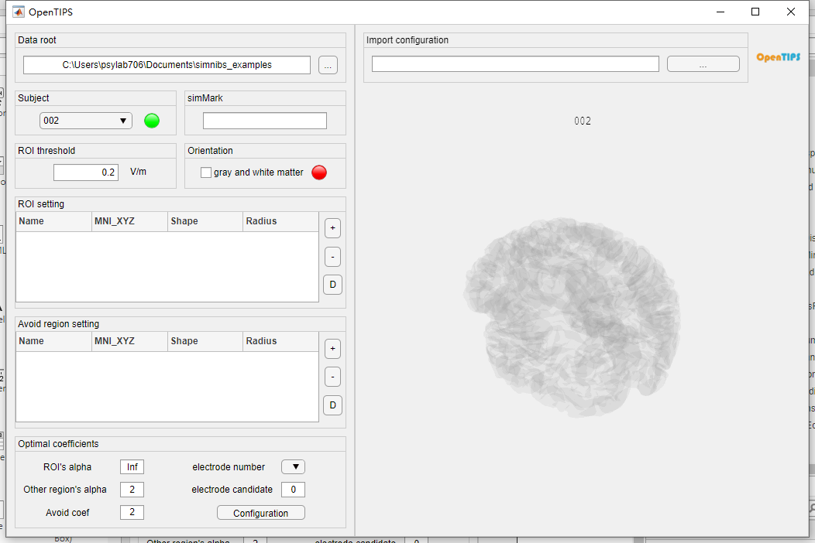

Slide 4
Sample point in MNI space
1. Nacc_L

Slide 5
输入数据格式leadfield
ROI :
E0: N*3*L
C : Nc*4
Coordinates : N*3
Area/Volume : N*1
CORTEX:
E0: N*3*L
Coordinates : N*3
Area/Volume : N*1
N : 顶点数目(ROI 4000, CORTEX Surface/Volume)
L : 备选电极数目（76）
Nc : 电极花样排布数

Slide 6
流程概述：
1. ROI
根据阈值筛选可能的优化方案（包括排布组合和电流分配方式）
2. CORTEX
根据指标计算出最佳的4导优化方案
3. MORE2：elec6, elec8
优化方案进行排序。
迭代增加两个电极强化已有结果

Slide 7
指标： 比值 ROI/CORTEX
Peak
Max
More2 可能无效
Weighted Average
Dot
较Average合理。
square weighted average
使用电场能量作为指标。结果位于前两者之间
cubic or higher order average
高阶

Slide 8
step
No matter in ROI or Cortex phase, the calculation takes two steps, Basic and Method.
1. Basic : calculate the envelop electric field intensity at every node
2. Method: get the max or mean (or square mean, etc) of these electric fields.
Note: the Method step takes more than 50% time comsumption.
ROI
cortex

Slide 9
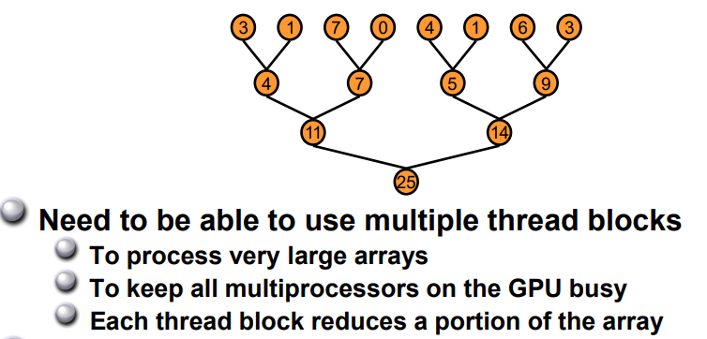
Parallel reduction
accelerate in Method step
two level : ①shared memory ② warp

Slide 10
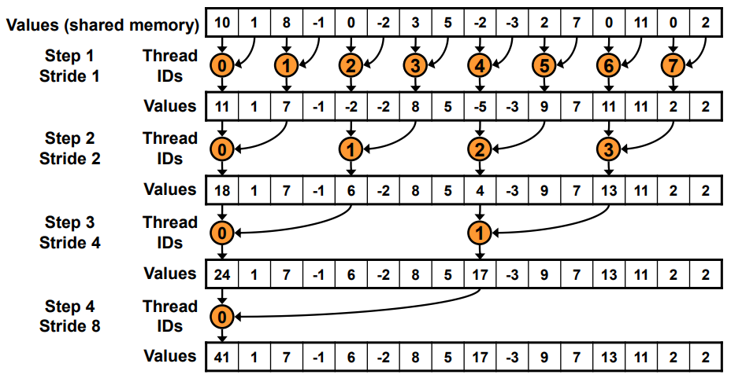
example (bank conflict)

Slide 11
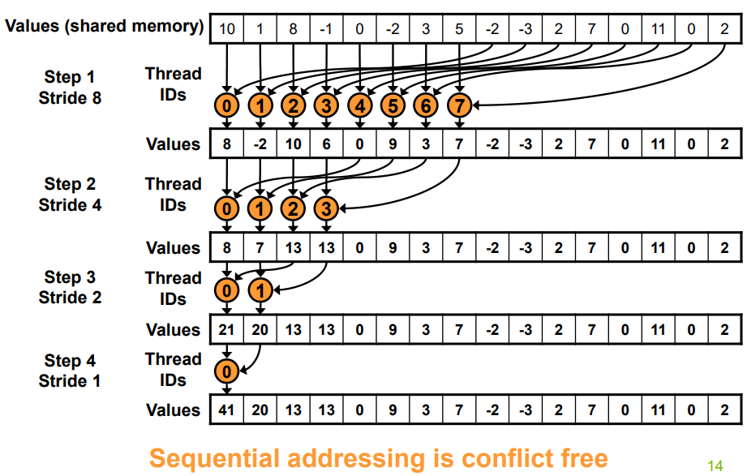
example (conflict free)

Slide 12
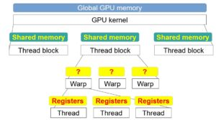
In warp
When s <= 32, we have only one warp left
Instructions are SIMD synchronous within a warp.

Slide 13
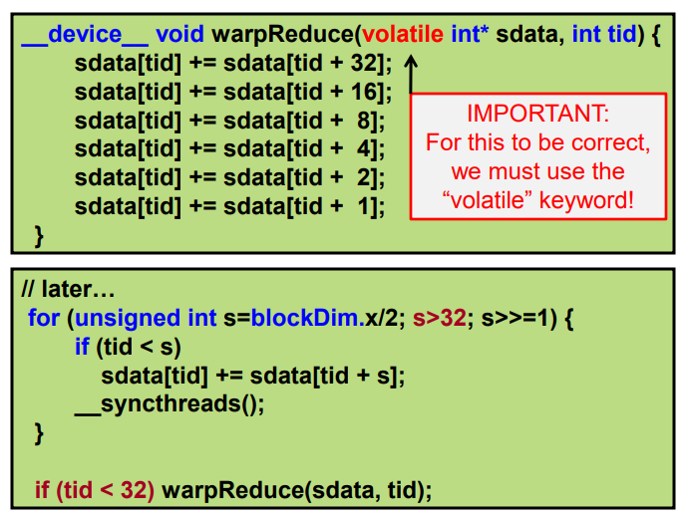
Code
warp
shared memory

Slide 14
Multi electrode dillemma
How to rotate these two squares to get the biggest overlap area?
a). rotate one square one time
(local extremum)
b). rotate two squares simutaneously
(expensive in calculating)

Slide 15
函数名称调用结构图
ROI
CORTEX
MORE2
output:
T1
T2
T3, U3
U(S2U)

Slide 16
More2 算法说明（need update)
More2
More2b: cublas to kernel function
More2c: blockSize/gridSize of kernel function
More2d: parallel design
1. 一次分配Ki*N 个线程计算Ki个C （速度不变）
2. 分配Ki个block，每个里面1024个线程（400ms -> 450ms)

Slide 17
T4m
U4m

Slide 18
3 levels in TIs’ parameters
1. the number of electrodes
2. the power exponent of ratio
3. add the penalty

Slide 19
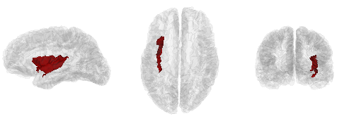

Slide 20
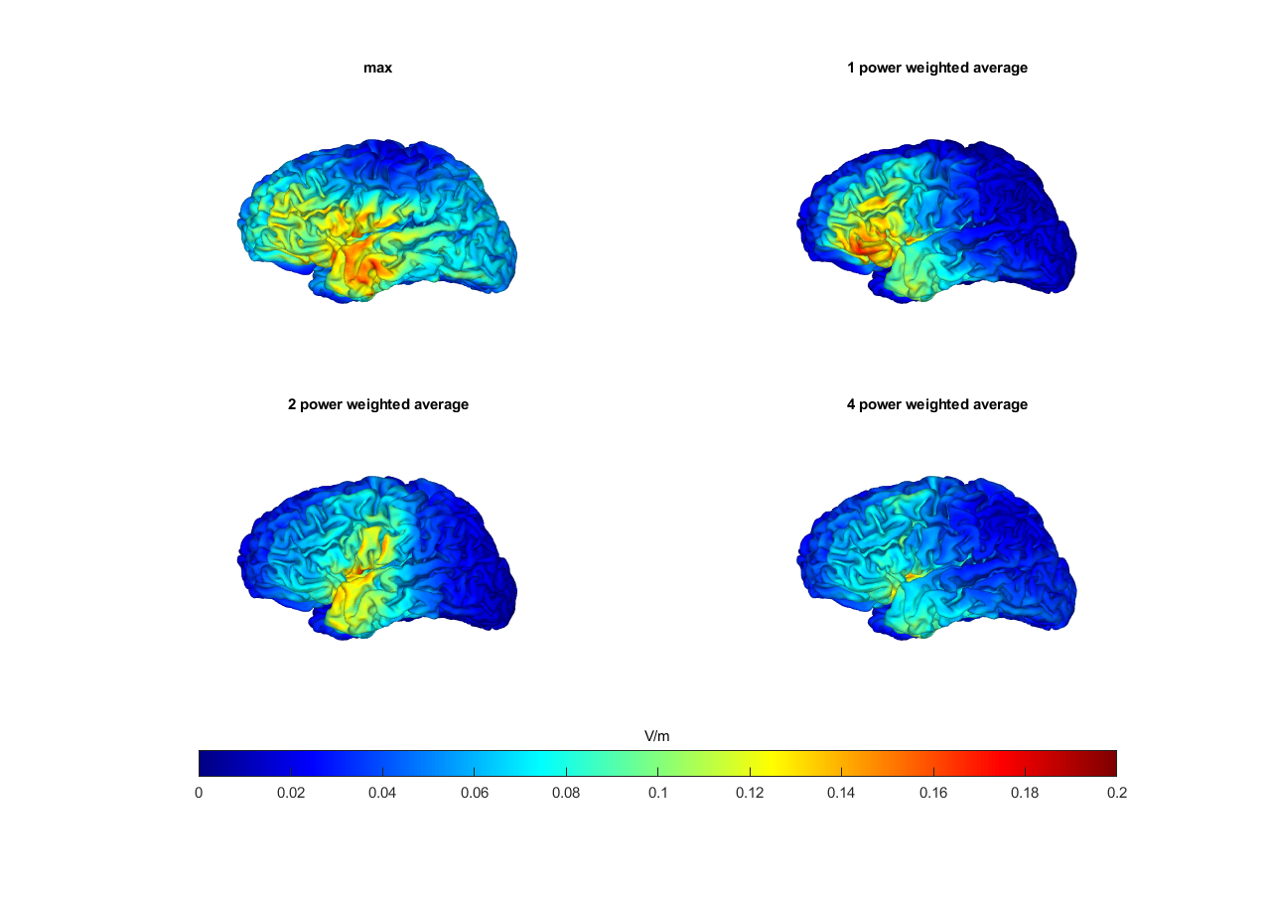

Slide 22
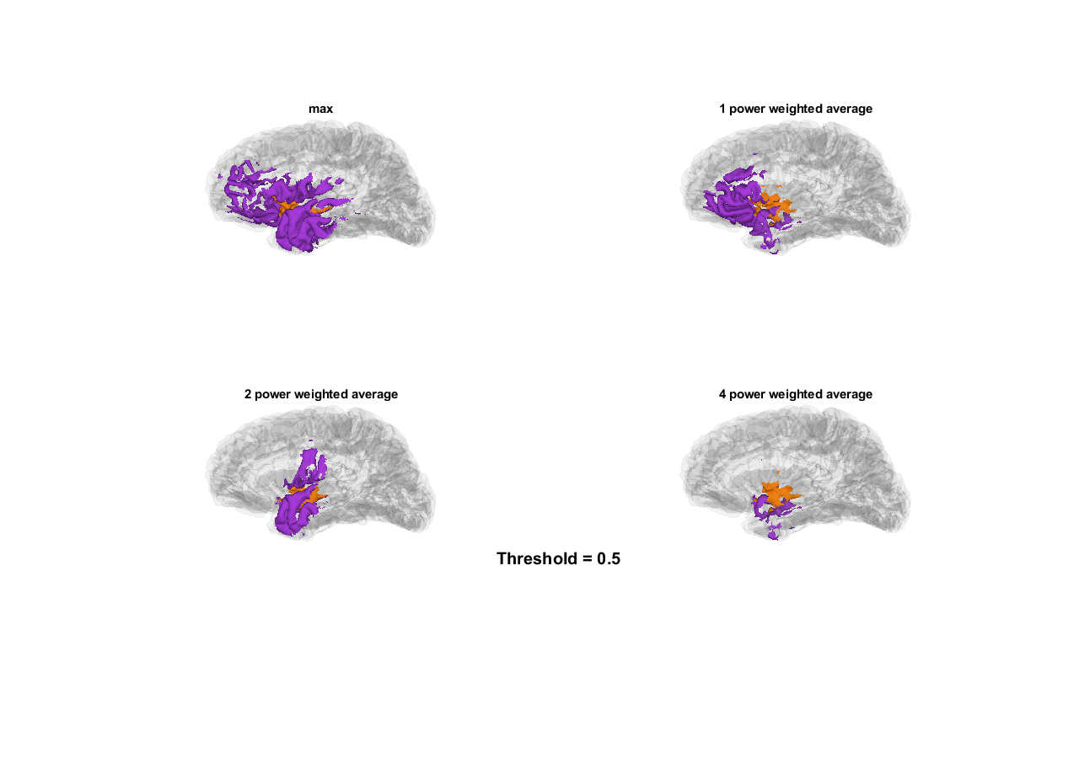

Slide 25
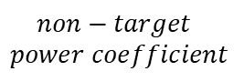
(A)
$$non−target$$
$$power coefficient$$
0
1
2
4
(B)
Target
Non-target

Slide 26
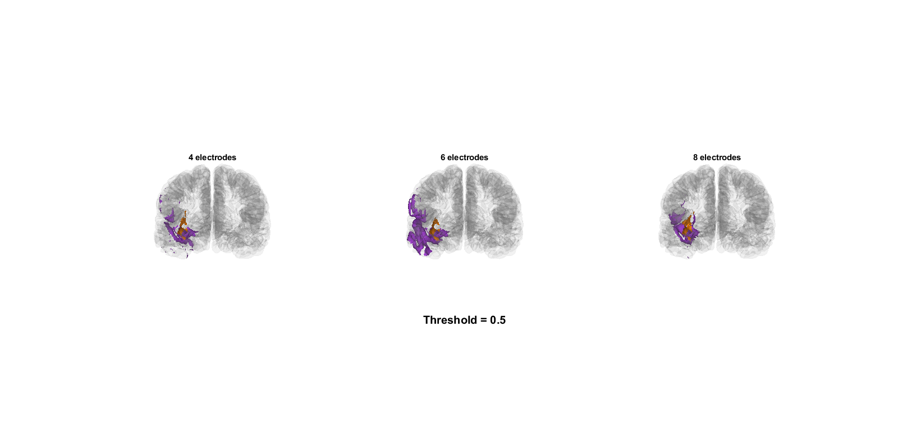

Slide 27
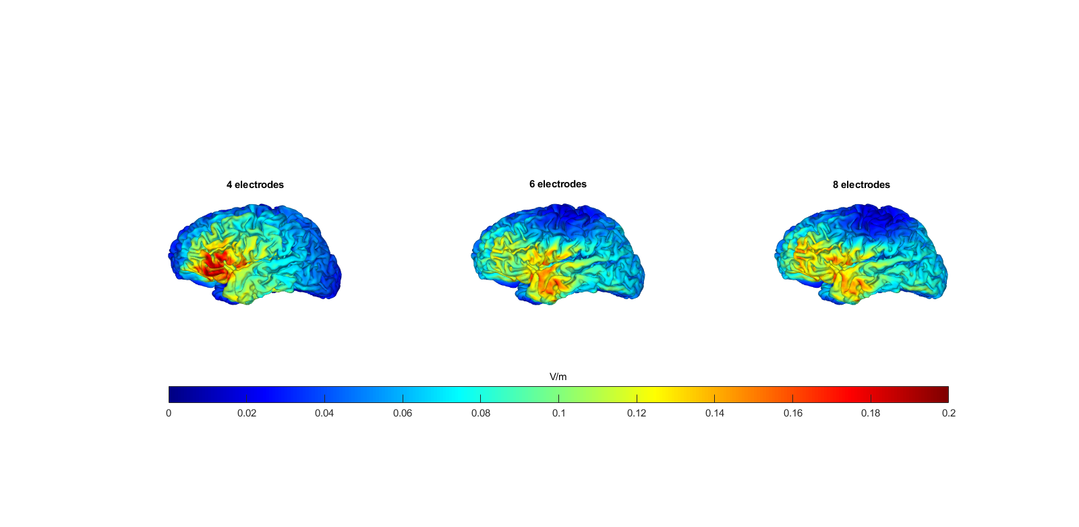
Notes:
Elec 原图1

Slide 28
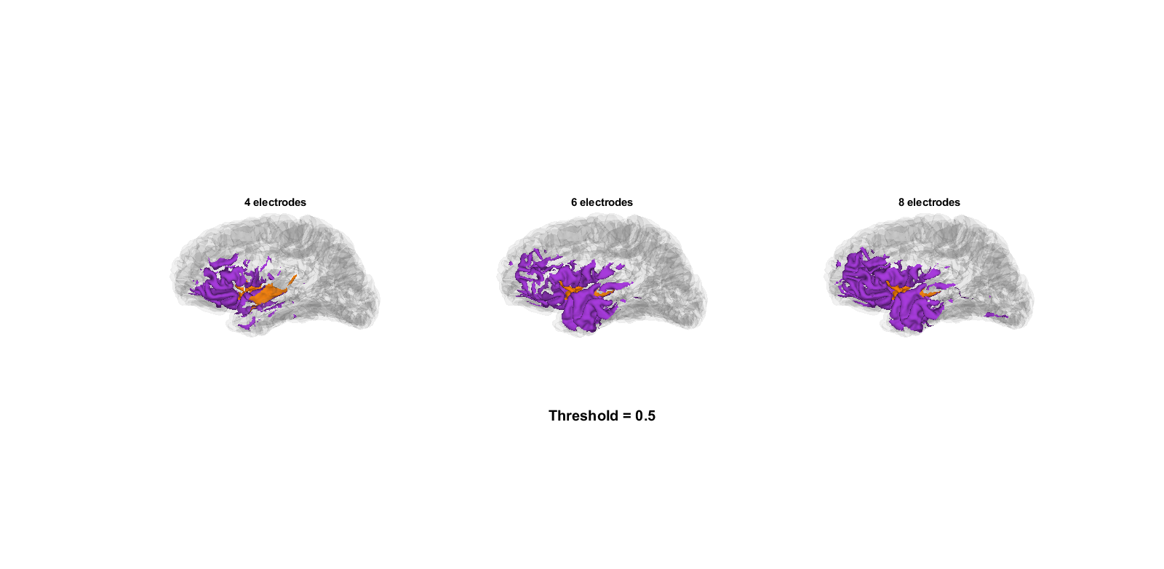
Notes:
Elec原图2

Slide 29
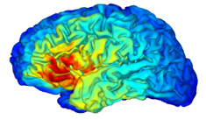
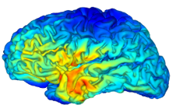
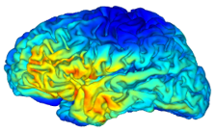
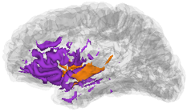
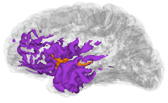
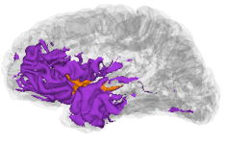
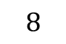
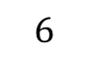

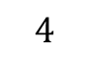
(A)
$$electrode$$
$$number$$
$$4$$
$$6$$
$$8$$
(B)
Target
Non-target

Slide 30
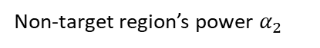
Non-target region’s power $α_{2}$

Slide 31
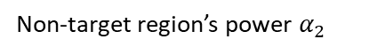
Target
Non-target
Suprathreshold brain area proportion
Suprathreshold brain area proportion
Non-target region’s power $α_{2}$
Electrode number

Slide 32
Distance to gravity center (mm)
Non-target region’s power $α_{2}$
Electrode number

Slide 33
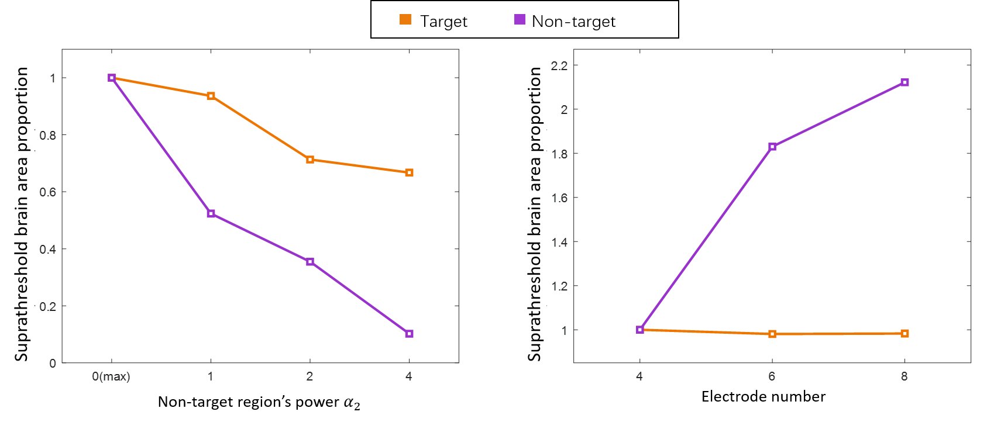
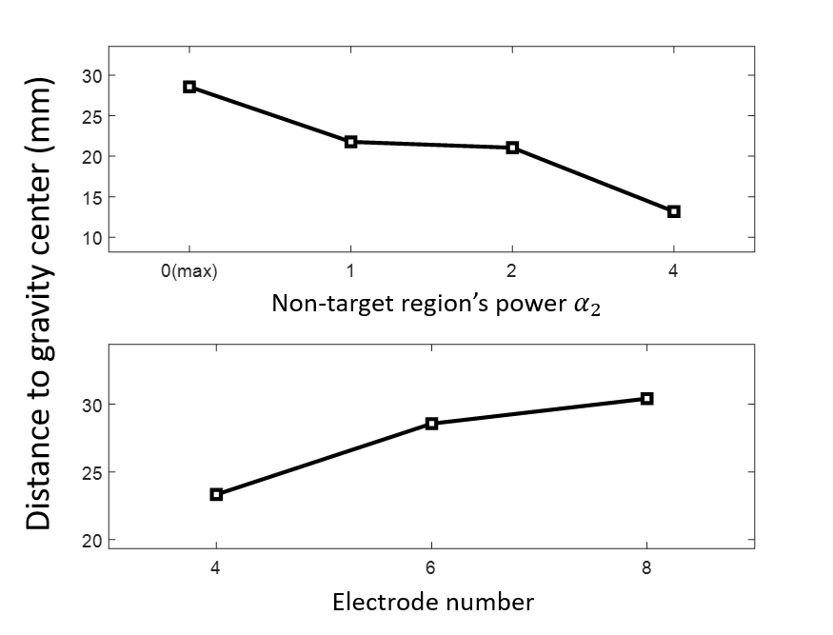
(A)
(B)
(C)

Slide 34
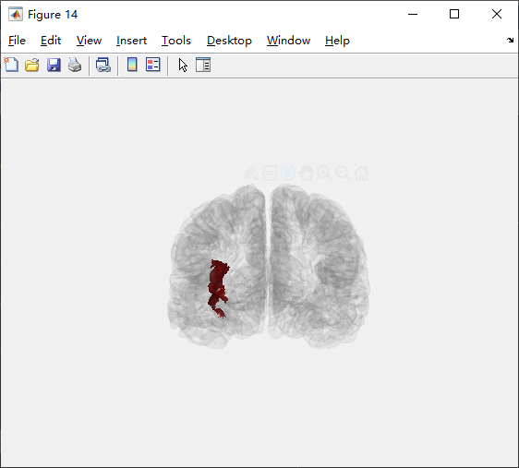
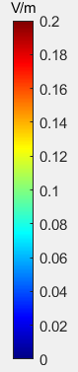
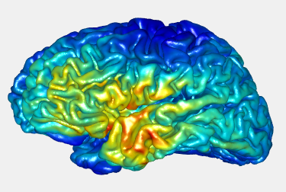
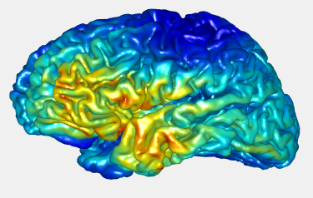
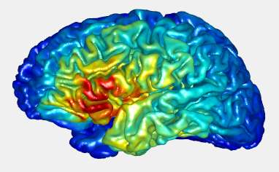
4-》6-》8 method: 0 / 0
Peak Ratio: 1.1143
1.1809
1.199

Slide 35
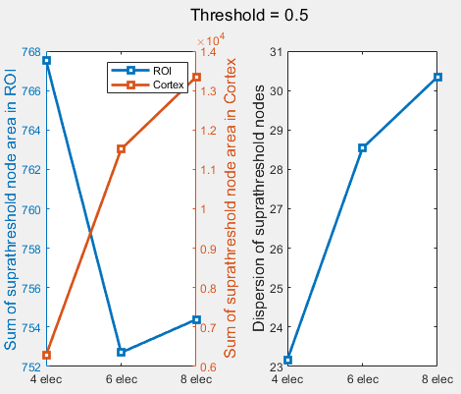
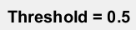
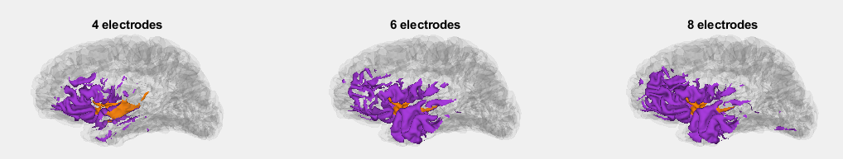

Slide 36
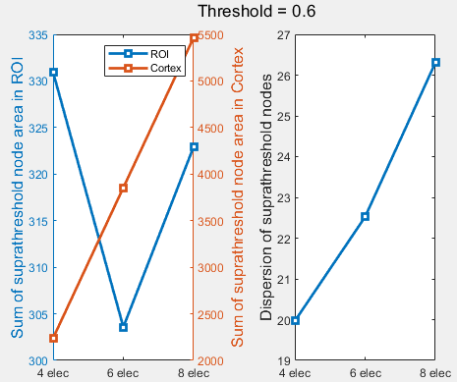
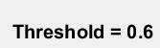
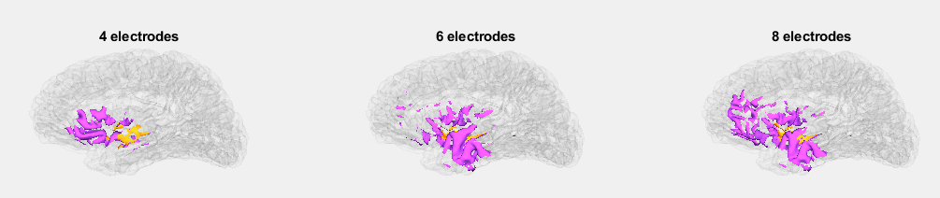

Slide 37
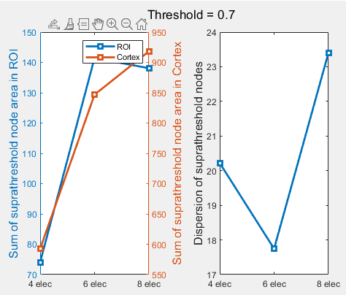
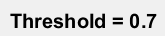
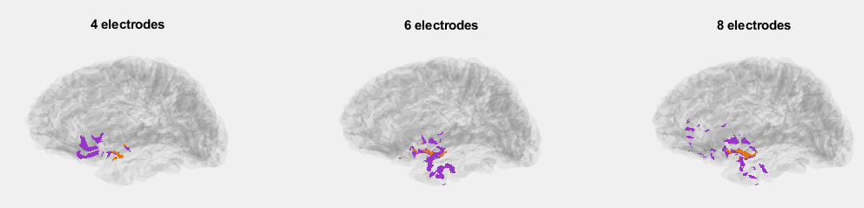

Slide 38
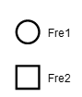
mA

Slide 39
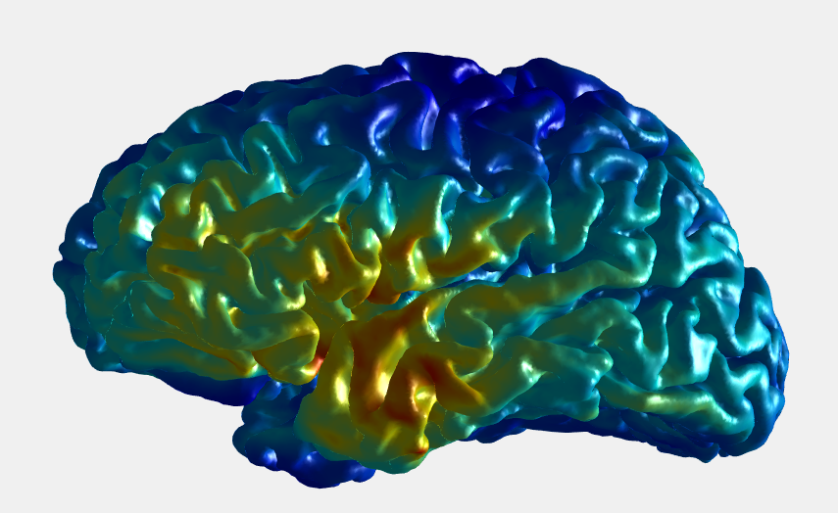
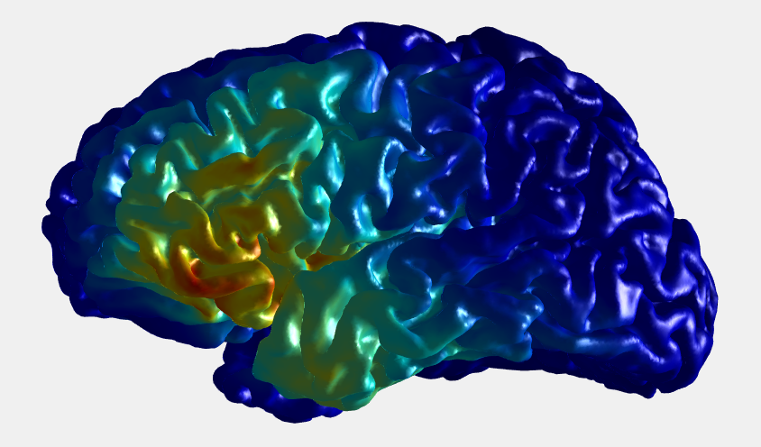
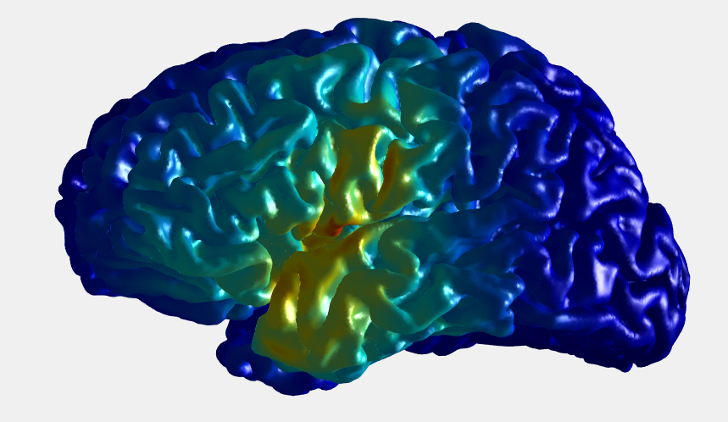
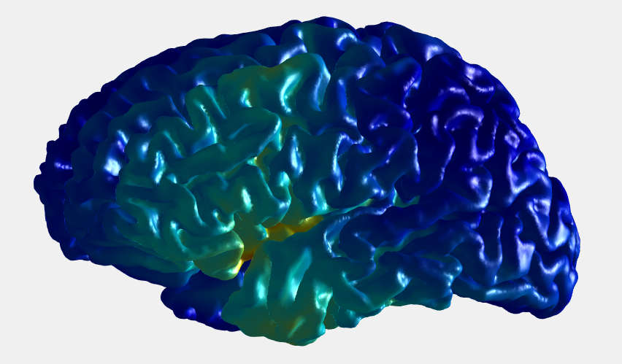
method_ROI = 0 (max) (elec = 6) method_Cortex: 0>1>2>4
0
1
2
4

Slide 40
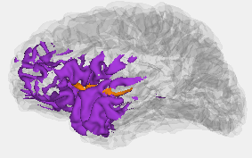
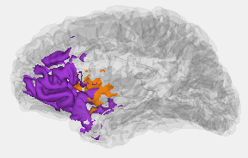
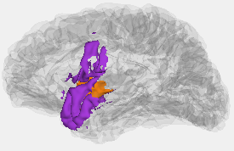
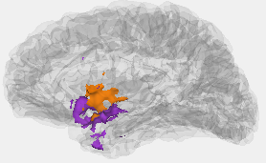




$$α_{2}=0 (max)$$
$$α_{2}=1$$
$$α_{2}=2$$
$$α_{2}=4$$

Slide 41
Suprathreshold brain area proportion
Average distance to gravity center(mm)

Slide 42
0
1
2
4
mA

Slide 44


Slide 45

ACC vs DLPFC

Slide 46


Slide 47


Slide 48


Slide 49

$$penalty$$
$$coefficient$$
1
2
2.5
3
(A)
(B)
Target
Penalty
Irrelevant

Slide 50
Suprathreshold brain area proportion
Penalty coefficient

Slide 51




Maximize ACC without penalty
Max/max(6 electrodes)
Max/power(6) (6 electrodes)

Slide 52
定义惩罚区域（ACC vs DLPFC)

Slide 53


Penalty coefficient (p=5)
Max/max(6 electrodes)
(P = 1 contrast)

Slide 54





Slide 55



P = 5, power2/power4, 6 electrodes

Slide 56
1
2
2.5
3
mA

Slide 57












CPU
大脑区域的划分
备选电极位置排列组合
目标区域
无关区域
脑网格内逐点求解两向量投影最小值问题
GPU
$$最大值max({ E1)}^{ }/mean⁡(E2)$$
四导电极参数优化${\overline{E1}}^{α}/{\overline{E2}}^{β}$
$$能量max({ E1)}^{ }/mean⁡(E2²)$$
$$均匀性mean({ E1²)}^{ }/mean⁡(E2)$$
六导电极参数优化
$$聚焦性mean({ E1²)}^{ }/mean⁡({E2}^{4})$$
八六导电极参数优化

Slide 58

高频电场A:2000HZ
振幅（mA)
时间（ms）
高频电场B:2020HZ
振幅（mA)
时间（ms）
低频耦合电场（20HZ)
振幅（mA)
时间（ms）

Slide 59


Slide 60


Slide 61



4个电极（每个频率2个）
6个电极（每个频率3个）
8个电极（每个频率4个）
低频耦合电场强度（V/m)

Slide 62


Slide 63




最大值
加权平均值
加权均方值
加权四次方值
低频耦合电场强度（V/m)

Slide 64
Hdf5文件
ernie_leadfield_EEG10-10_UI_Jurak_2007.hdf5
1*2 struct
/mesh_electrodes
/mesh_leadfield

